Slide 1

World Cup 2022
SAYAN KARMAKAR
last update = 10/11/2022

Slide 2
“The kid’s good point is that he feels he doesn’t have much skill. It’s this kind of person that will keep on improving.”
- Mizuno tatsuya

Slide 3
Questions that we are facing.
Parentage of players preferred Foot.
Most common players age segment.
Most common players weight segment.
Overall deferens in Top teams performers.

Slide 4
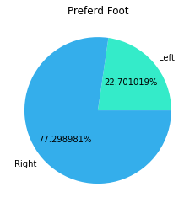
Parentage of players preferred Foot.
We can see that 77.298% players prefer there right foot and 22.701% players prefer there left foot.

Slide 5
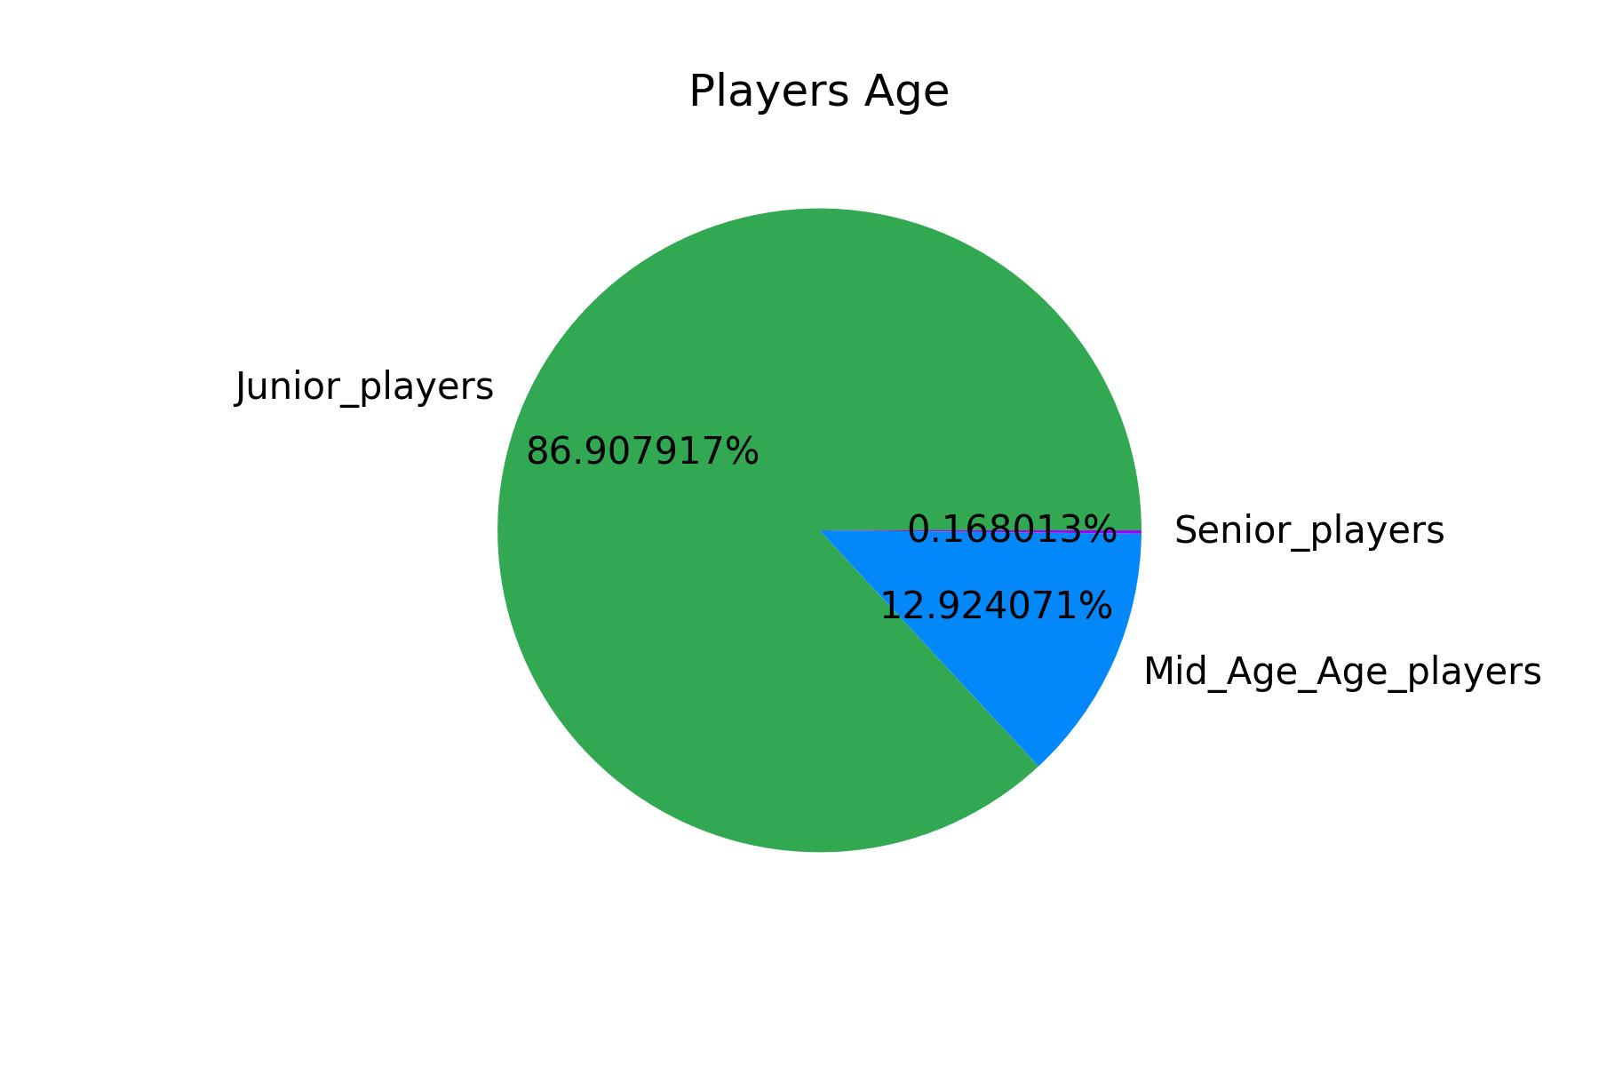
Most common players age segment.
We divide players in 3 age group:
Junior Players(above 20 under 30) = 86.90% or 13449 players.
Mid Age Players(above 30 under 40) = 12.92% or 2000 players.
Senior Player(above 40) = 0.16% or 26 players

Slide 6
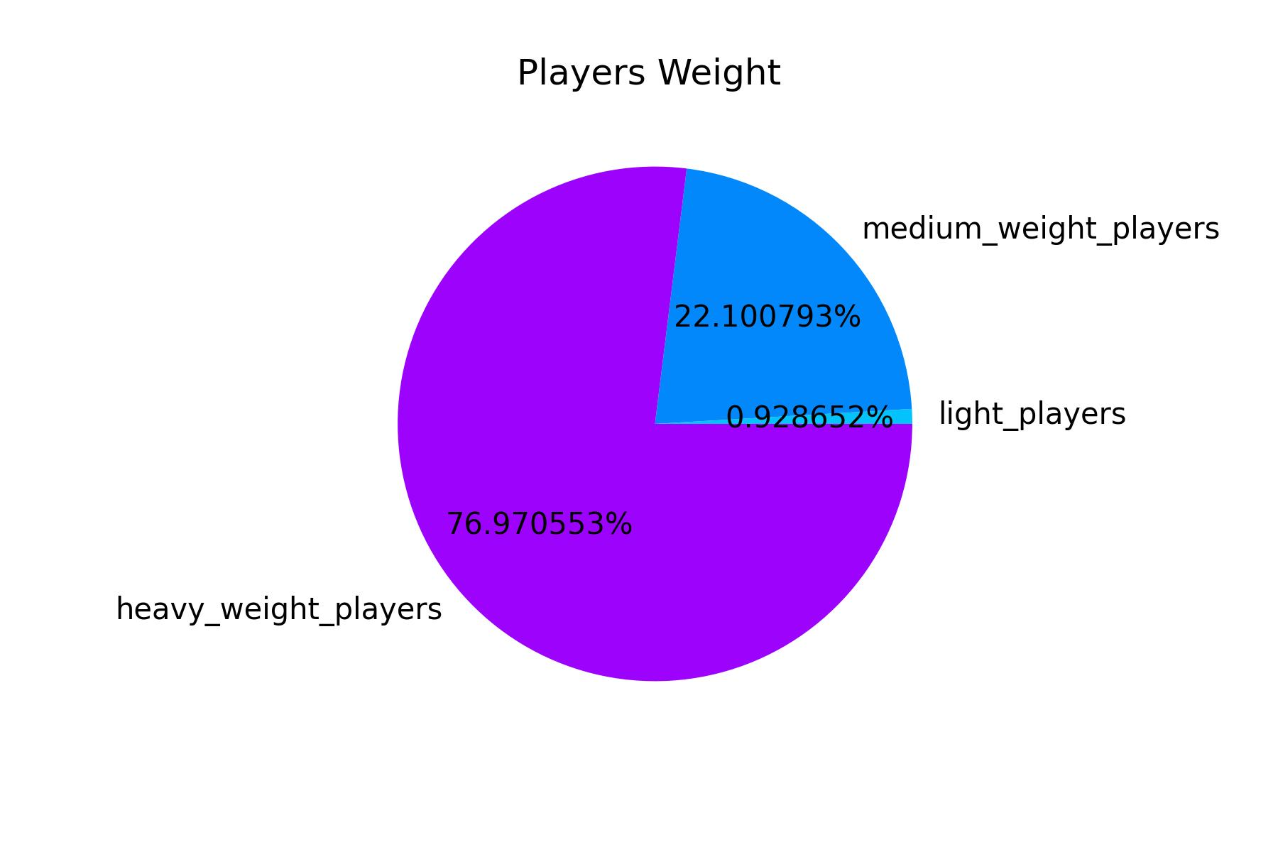
Most common players weight segment.
We divide players in 3 weight group:
Light Players = 0.928%
Medium Weight Players = 22.10%
Heavy weight players = 76.97%

Slide 7
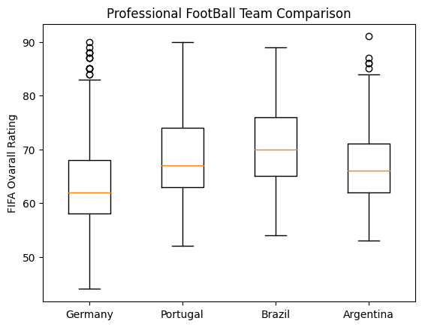
Overall deferens in Top teams performers.
From top 5 teams we can see Brazil is more stronger team than others.

